Slide 1


Travel Rhythm
School of Computer Engineering & Technology
Presentation for FY Mini Project
-Tourism and Travels
Guide -Mrs. Farhana Shaikh
Members
131 - Gauri Kardekar
134 - Mayur Wakhare

Slide 2
INDEX
1)Introduction
2)Problem Statement
3) System Architecture Diagram
4) Block Diagram
5)Methodology
6)Complete Implementation
7)Result /output
8)References

Slide 3
INTRODUCTION
According to the United Nations World Tourism Organization (UNWTO), tourism entails the movement of people to countries or places outside their usual environment for personal or business/professional purposes. These people are called visitors.
Tourism boosts the revenue of the economy, creates thousands of jobs, develops the infrastructures of a country, and plants a sense of cultural exchange between foreigners and citizens. The number of jobs created by tourism in many different areas is significant.
The data of the tourism company can be managed and displayed (graphically as well) using python programming language.
To facilitate tourism as a business, python programming can be used along with libraries and required data files.

Slide 4
Problem Statement :Write a python program for a tourism company to facilitate creation of customized holidays and plan a trip for customers (considering factors like budget and facilities)
PROBLEM STATEMENT
Objective:
1)Creation of account using Object Oriented Programming
2)To attain data of cost of hotel stay in different countries and tourist taxes.
3)To make a csv file of data and import it
4)Perform computation to calculate total bills(inclusive of all taxes) for specified number of members visiting a specific country
(pandas)
5)To plot a pie chart for most visited destinations by the travellers of the tourist company (Matplotlib.pyplot and numpy)

Slide 5
SYSTEM ARCHITECTURE DIAGRAM
.csv FILE
CODE
LIBRARIES
EDITOR
OUTPUT
DISPLAYING CHOICES
PLOTTING PIECHART
DISPLAYING COMPUTATION

Slide 6
Block Diagram
Definition of Problem
Collection of Data
Algorithm
Input from user
Training Dataset
Performing Computation
Plotting Pie chart
Displaying
output

Slide 7
METHODOLOGY
PLATFORM
Jupyter Notebook
TECHNOLOGY
Python
Pandas
NumPy
Matplotlib.pyplot

Slide 8
METHODOLOGY
In Python, object-oriented Programming (OOPs) is a programming paradigm that uses objects and classes in programming.
Pandas is a software library written for the Python programming language for data manipulation and analysis.
NumPy is one of the most commonly used packages for scientific computing in Python. It provides a multidimensional array object.
Matplotlib is a cross-platform, data visualization and graphical plotting library for Python and its numerical extension NumPy. Pie charts can be drawn using the function pie() in the pyplot module.

Slide 9
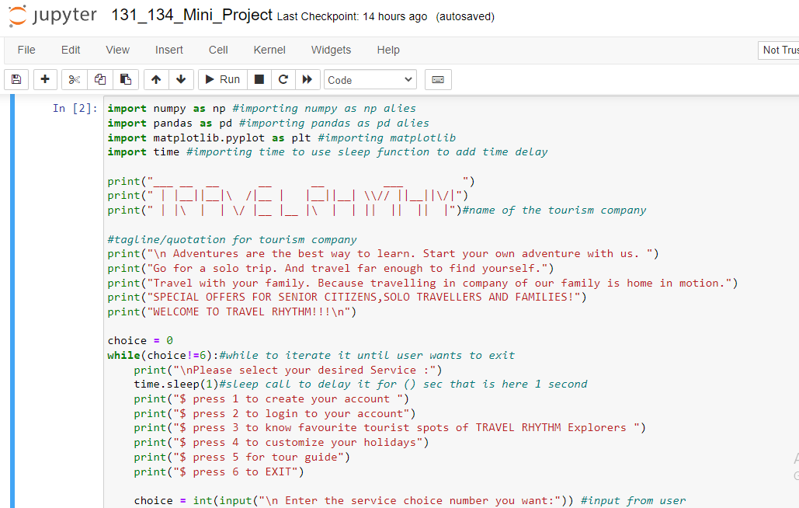
COMPLETE IMPLEMENTATION

Slide 10
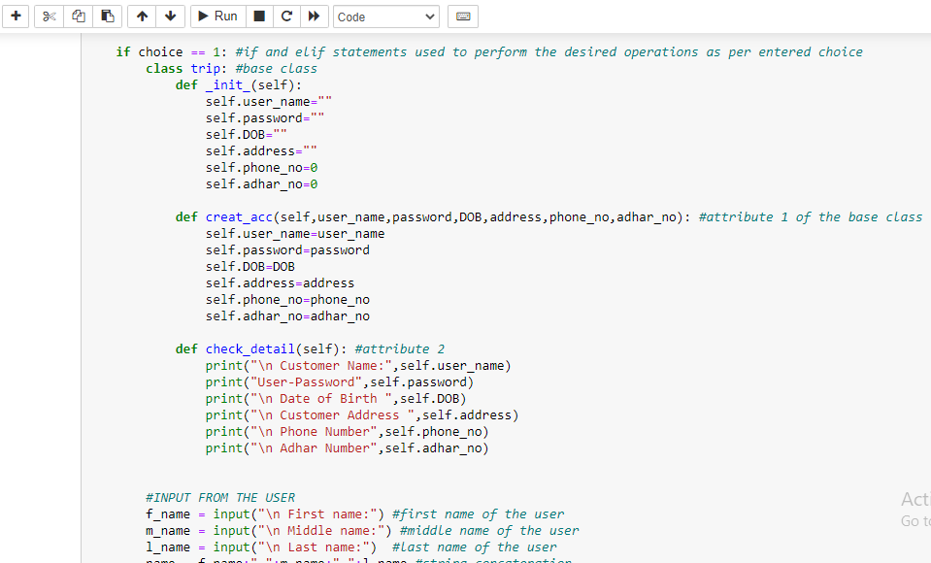
COMPLETE IMPLEMENTATION

Slide 11
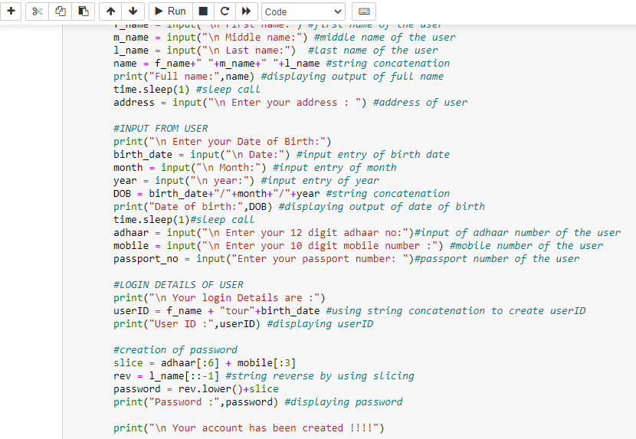
COMPLETE IMPLEMENTATION

Slide 12
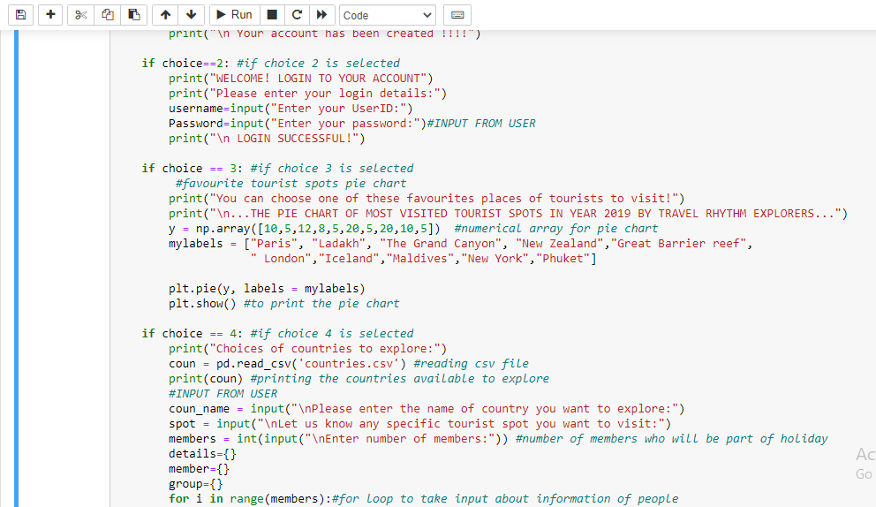
COMPLETE IMPLEMENTATION

Slide 13
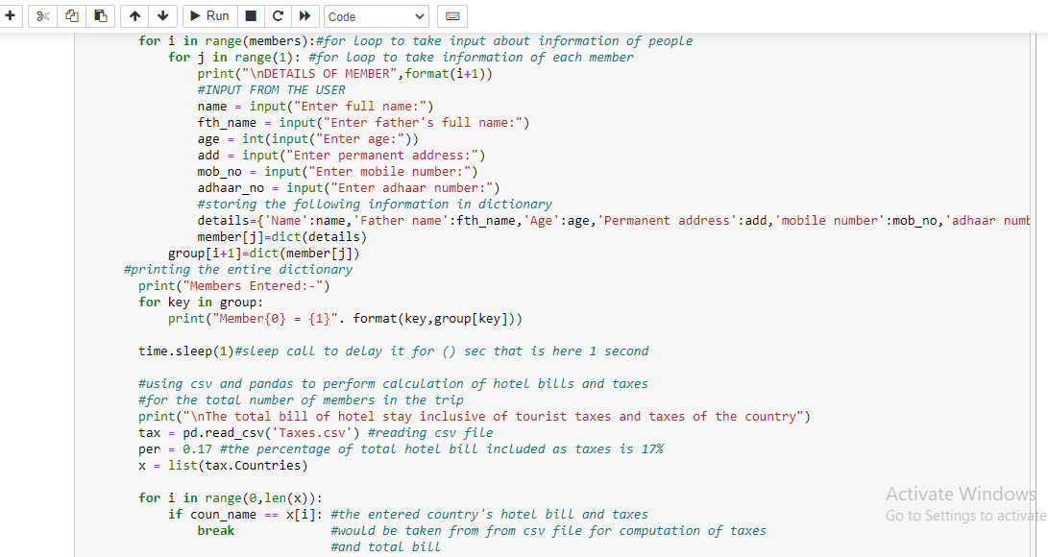
COMPLETE IMPLEMENTATION

Slide 14
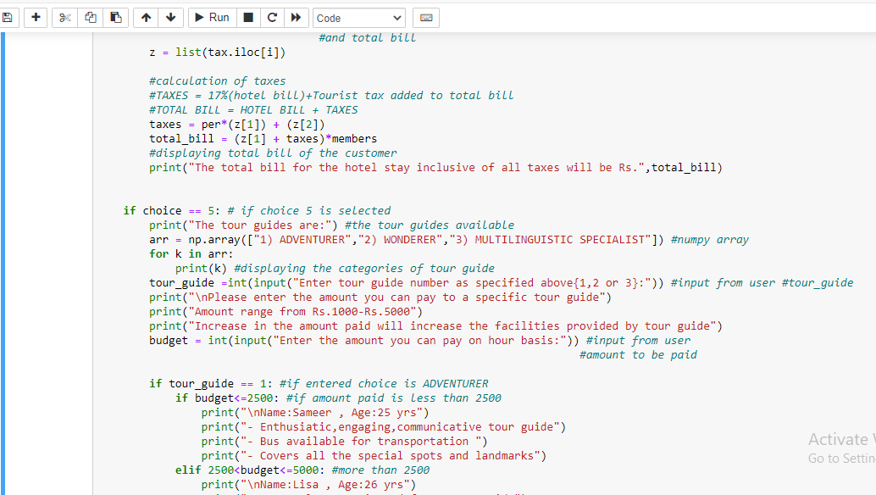
COMPLETE IMPLEMENTATION

Slide 15
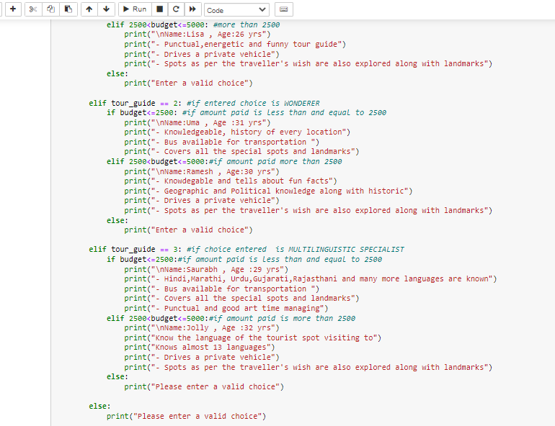
COMPLETE IMPLEMENTATION

Slide 16
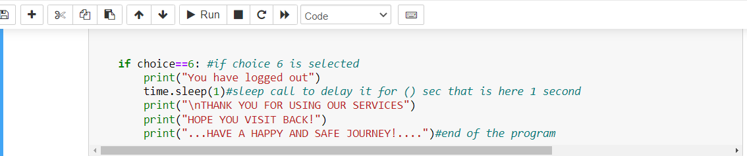
COMPLETE IMPLEMENTATION

Slide 17
RESULT/OUTPUT
After implementation, the code is executed successfully providing 5 choices to the user which include all the objectives mentioned in the problem statement.
OOPs is used for the creation of account.
Dictionary is used to take input of all the members who are part of the trip.
Pandas and csv file is used for the total bill calculation inclusive of all taxes for specific countries and specific number of members.
Matplotlib.pyplot and numpy is used for the plotting of pie chart.
Nested if else statement is used to allot a tour guide taking input from user.

Slide 18
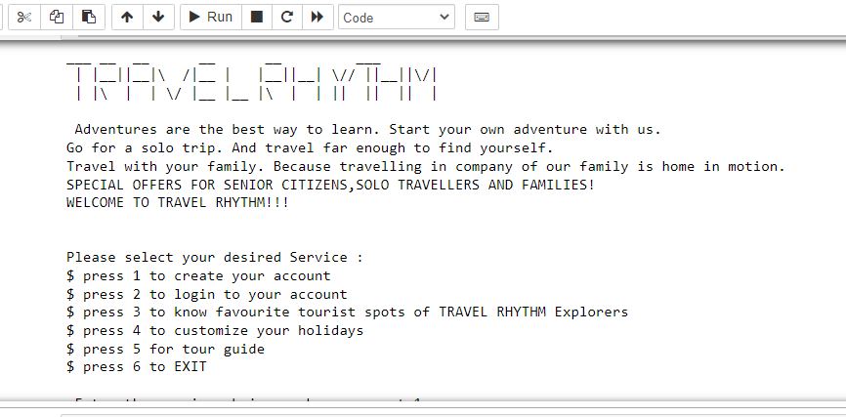
RESULT/OUTPUT

Slide 19
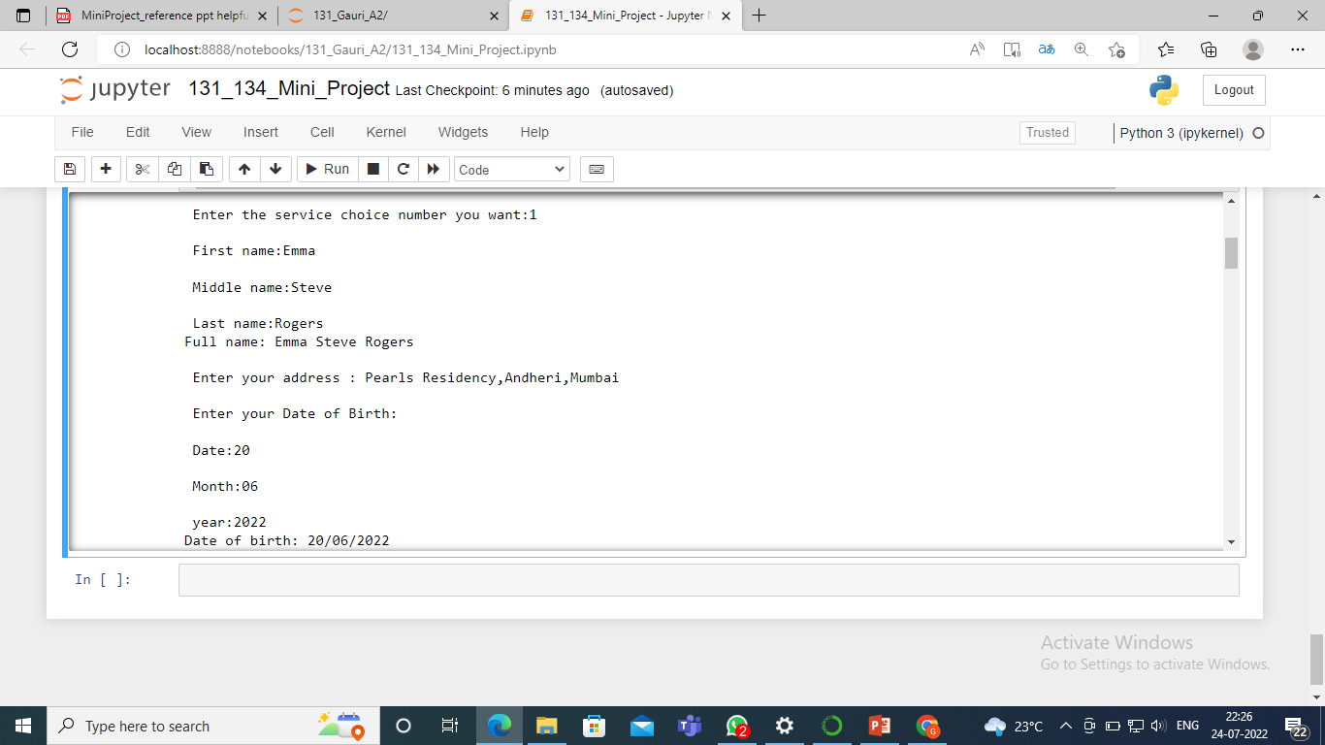
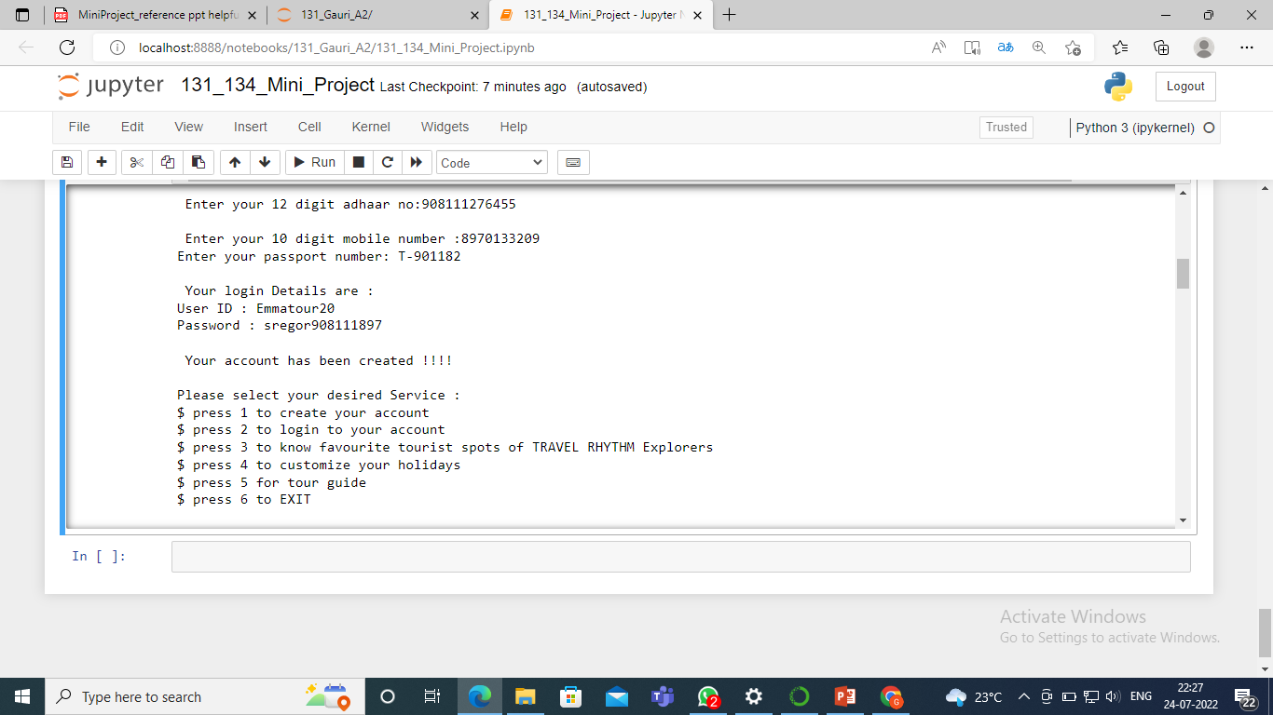
RESULT/OUTPUT

Slide 20
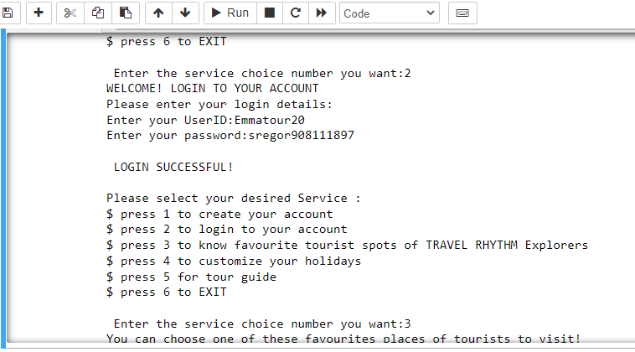
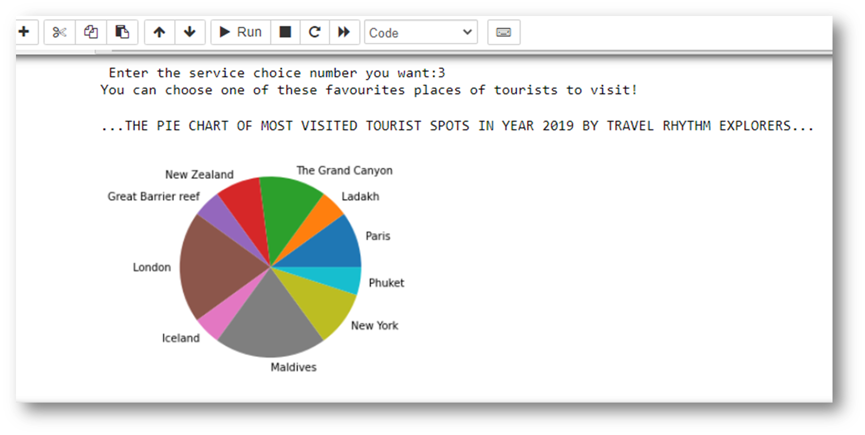
RESULT/OUTPUT

Slide 21
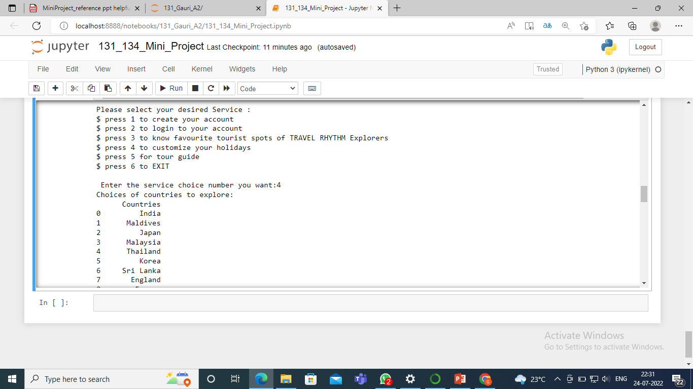
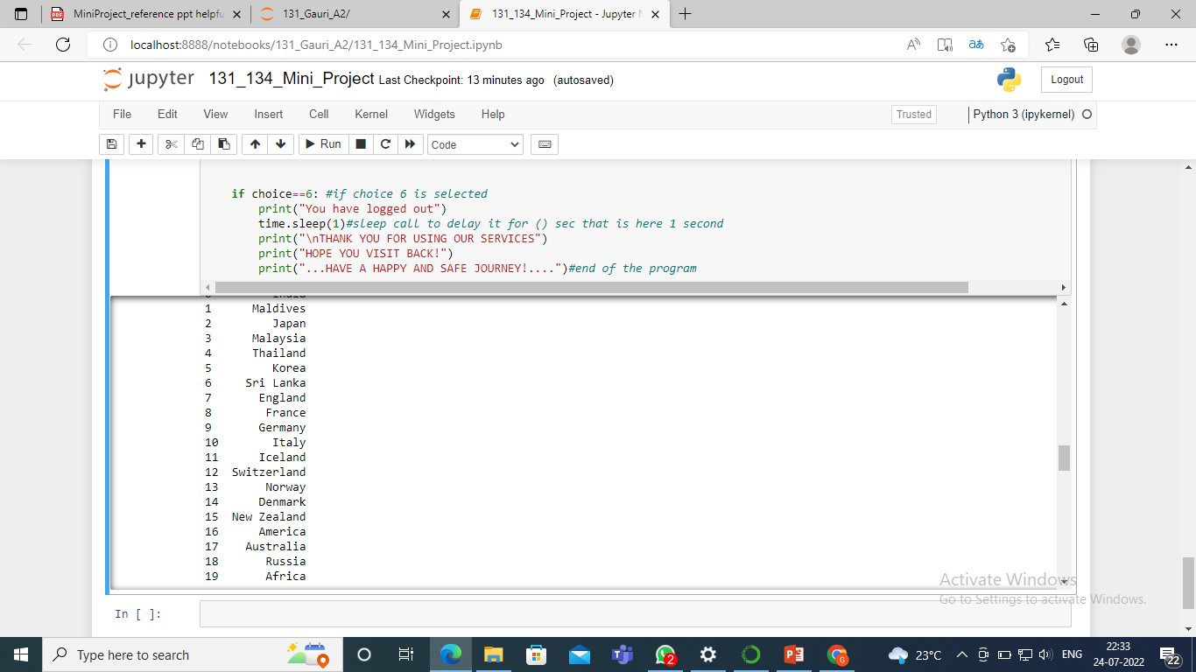
RESULT/OUTPUT

Slide 22
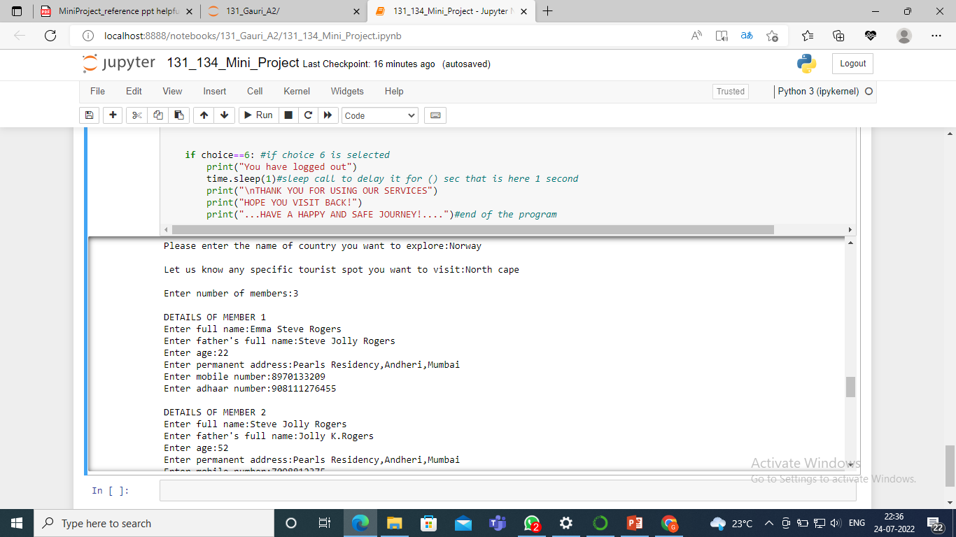
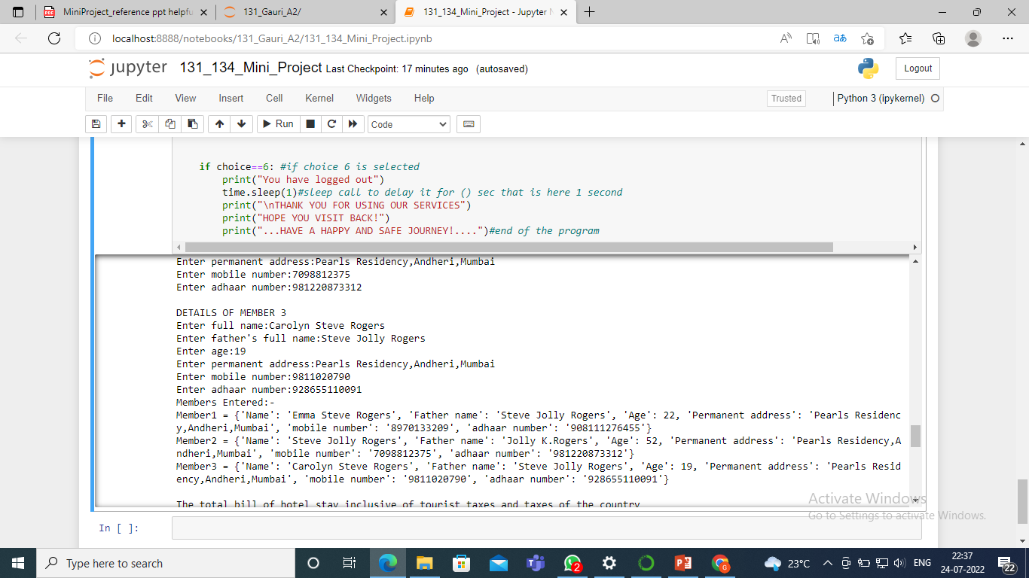
RESULT/OUTPUT

Slide 23
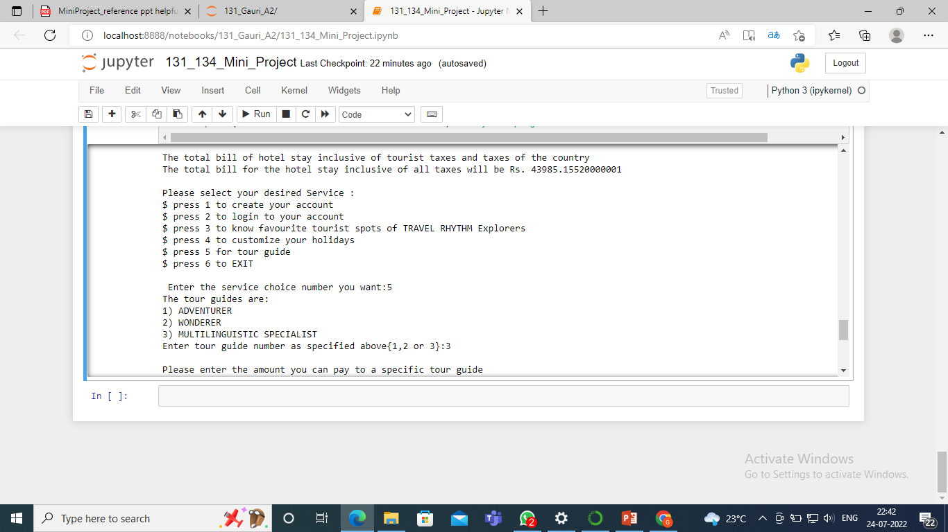
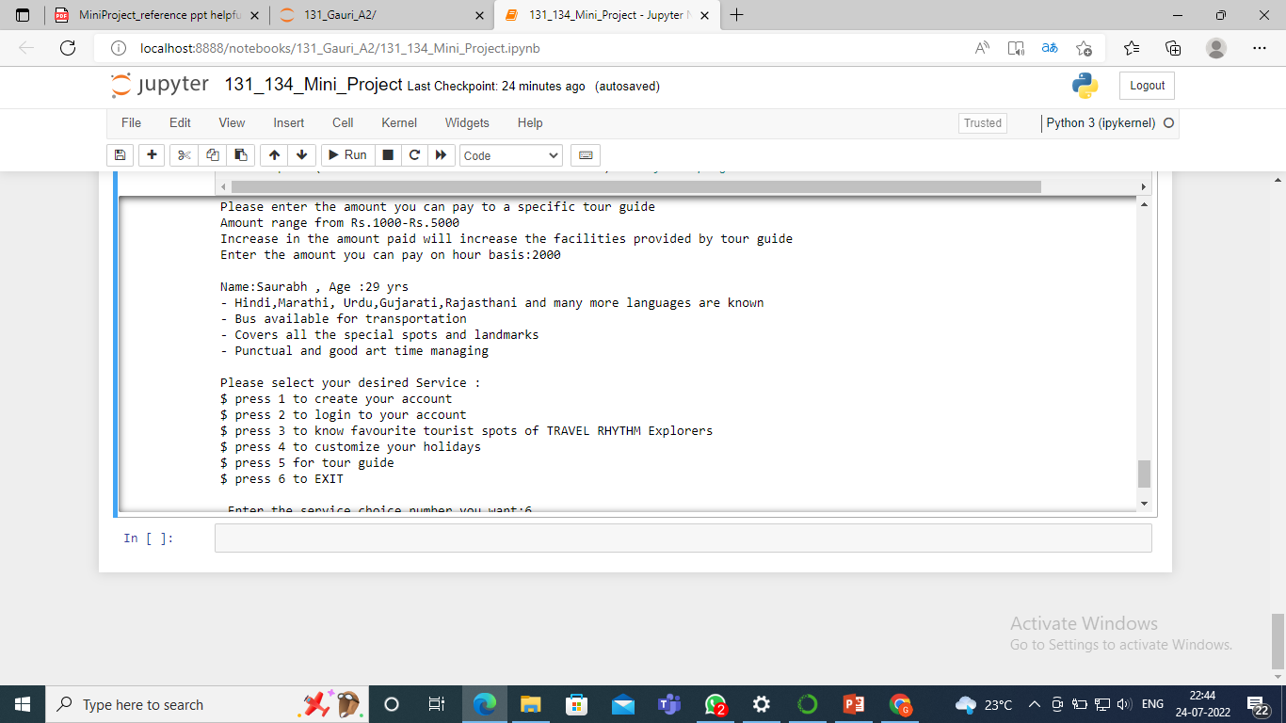
RESULT/OUTPUT

Slide 24
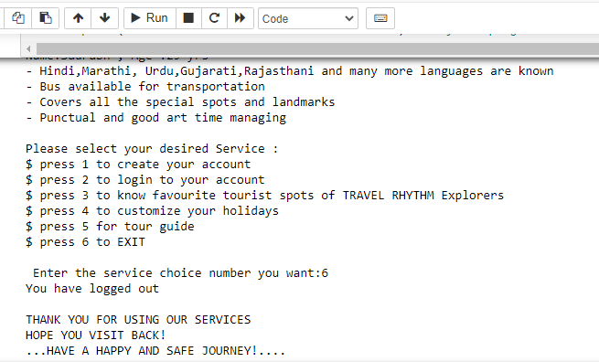
RESULT/OUTPUT

Slide 25
REFERENCES
https://www.w3schools.com/python/matplotlib_plotting.asp
https://www.wikihow.com/Calculate-Sales-Tax
https://www.insider.com/countries-that-require-a-tourist-tax-2019-2#france-has-a-taxe-de-sjour-4
https://youtu.be/6Z9b5nJTGgs

Slide 26
THANK YOU!

